Slide 1


Whole foods and housing prices
Robert Patterson
Ross Nicholson
Shreyashi Mukhopadhyay
Tinu NGO

Slide 2

Objective
Explore the relationship between the number of Whole Foods and housing prices in cities across the US.

Slide 3
Methodology
Retrieve CSV of Median Home Price & Median Rent for the top 100 most populous US Cities from Zillow dataset.
Use WeatherAPI to retrieve and append Lat/Lngs
Use GoogleAPI to retrieve and append “# of whole foods”
Plot median sale, median rent, and # of whole foods by city and make heatmaps for each.
Plot “# of whole foods” against median sale/rent price
Look for correlations.

Slide 4
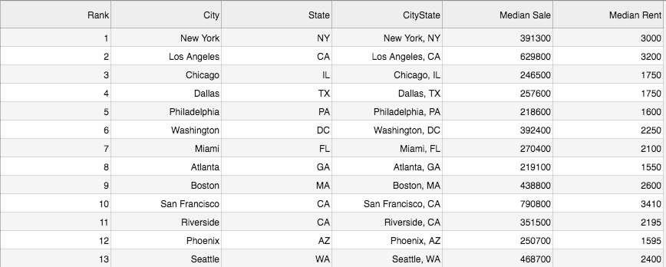
Original Zillow Data - Pulled from Kaggle

Slide 5
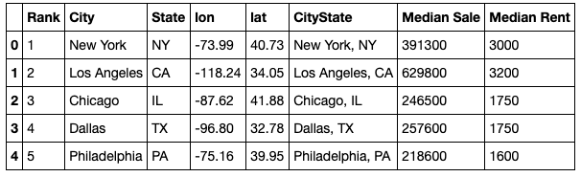
Use OpenWeather API to Append lat/long

Slide 6
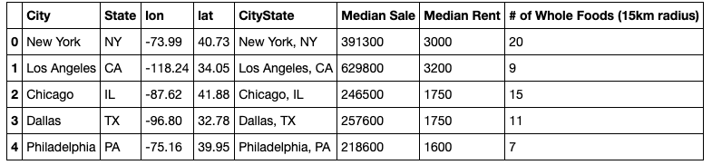
Use Google Places API to Append Whole Foods

Slide 7
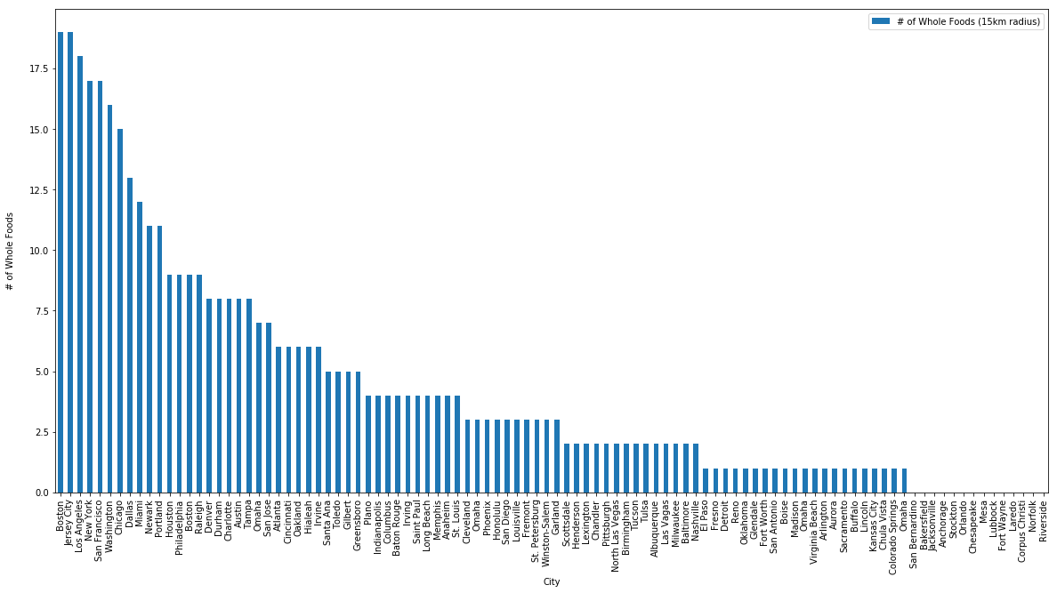
Number of Whole Foods by US City

Slide 8
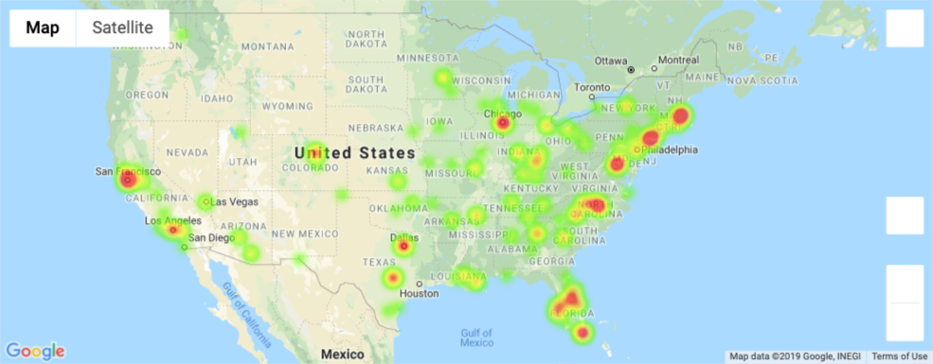
Heatmap of Whole Foods

Slide 9
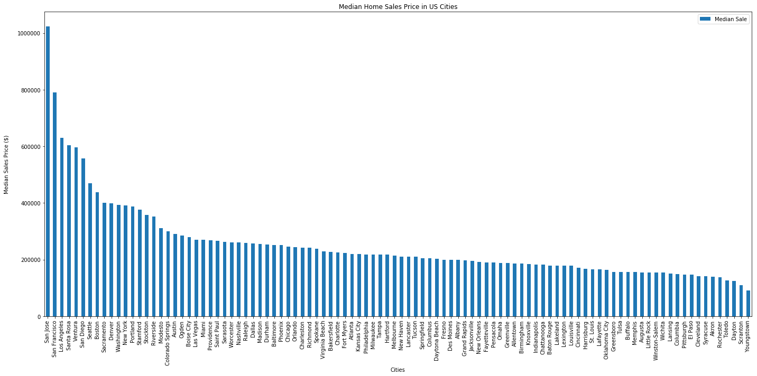
Median Home Sale Price by US City

Slide 10
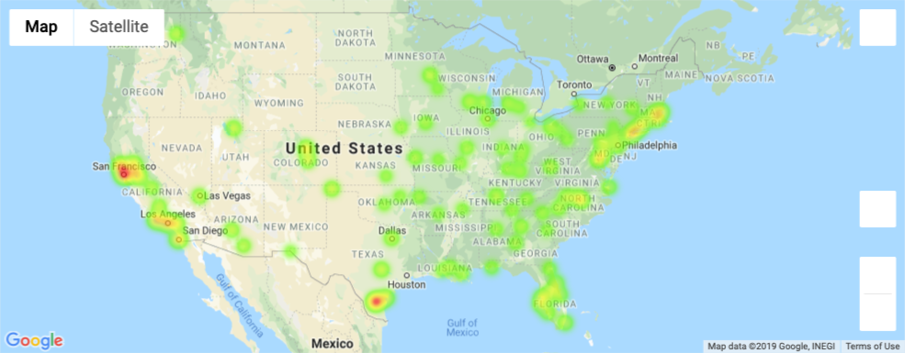
Heatmap of Median Home Sale Price

Slide 11
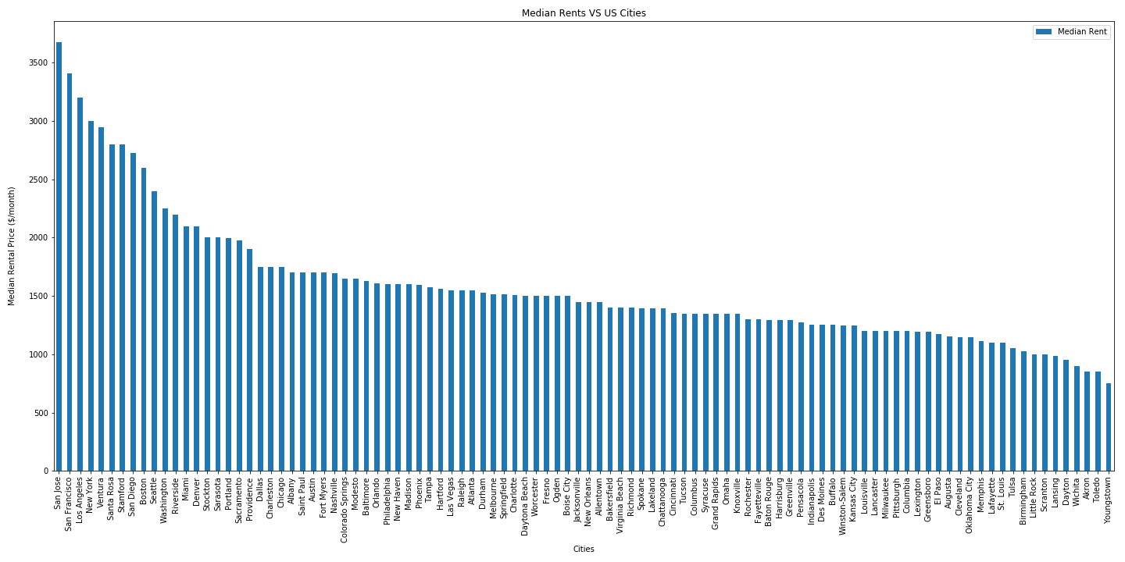
Median Rental Price by US City

Slide 12
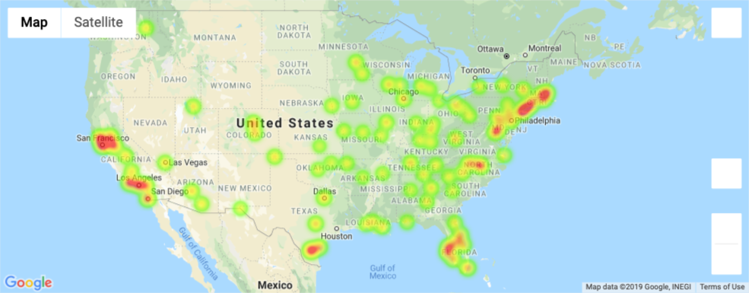
Heatmap of Median Rental Price

Slide 13
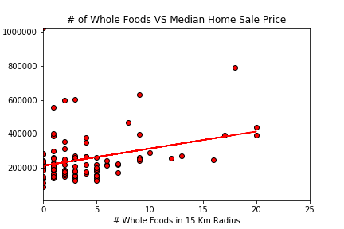
There is some relationship against Home Price

Slide 14
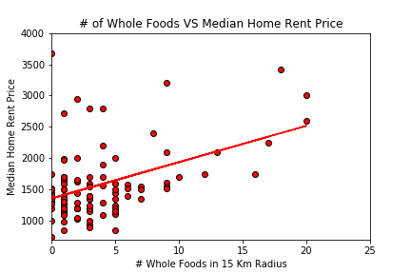
The relationship with rent is slightly steeper

Slide 15
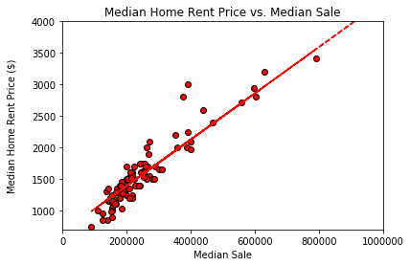
Sale vs. Rent is not an exact correlation
R2 = 0.8617

Slide 16
Conclusions
Higher housing prices were found around major metropolitan areas.
Potential correlation with housing prices and number of WFs, though the relationship is weak.
Rental prices appear to relate more positively with # of Whole Foods.
While there is evidence of correlation from these graphs, the original sampling of cities by population size may not be the best sampling criteria. For instance, Savannah, GA has a Whole Foods but is a lower population city, therefore not included in our study.
Next deep-dive is to look at this analysis at the neighborhood-level.

Slide 17
Thank you!

